Slide 1




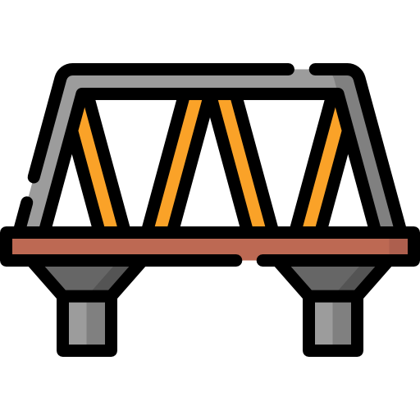




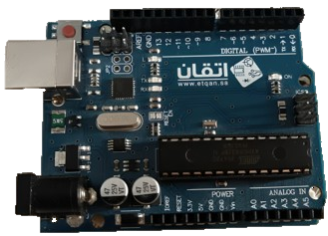
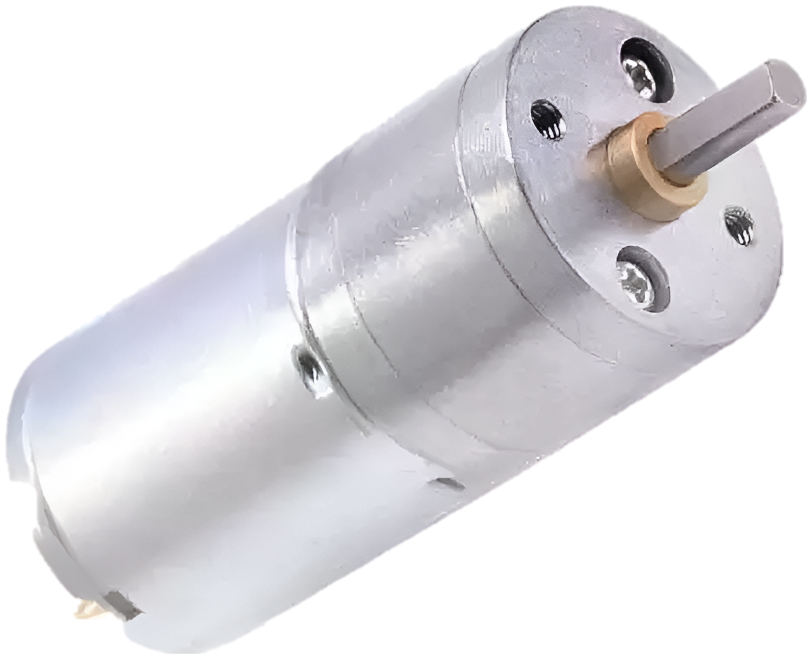
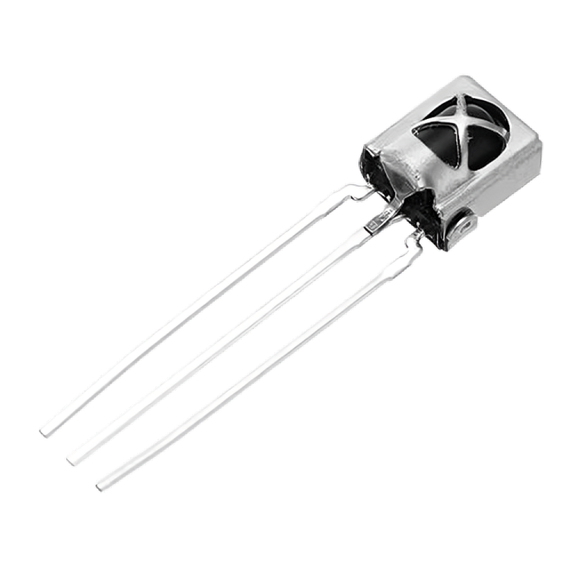
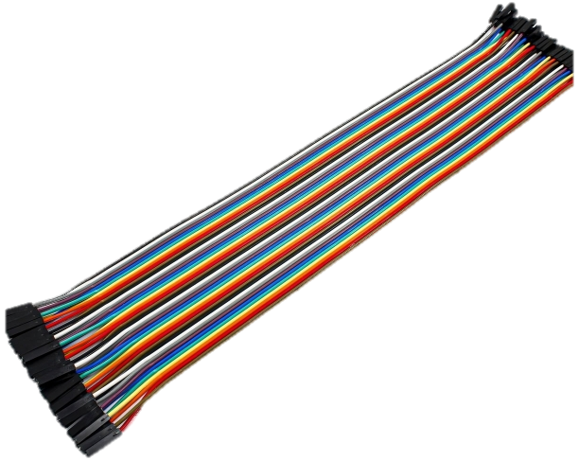
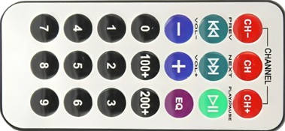
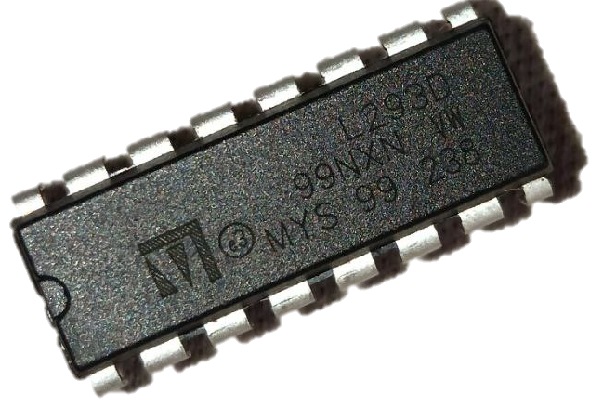
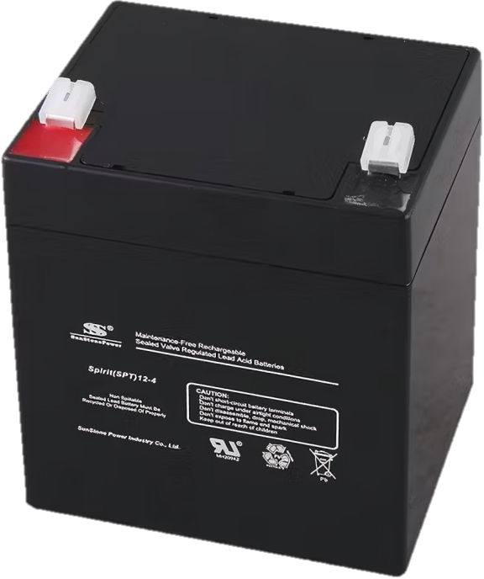


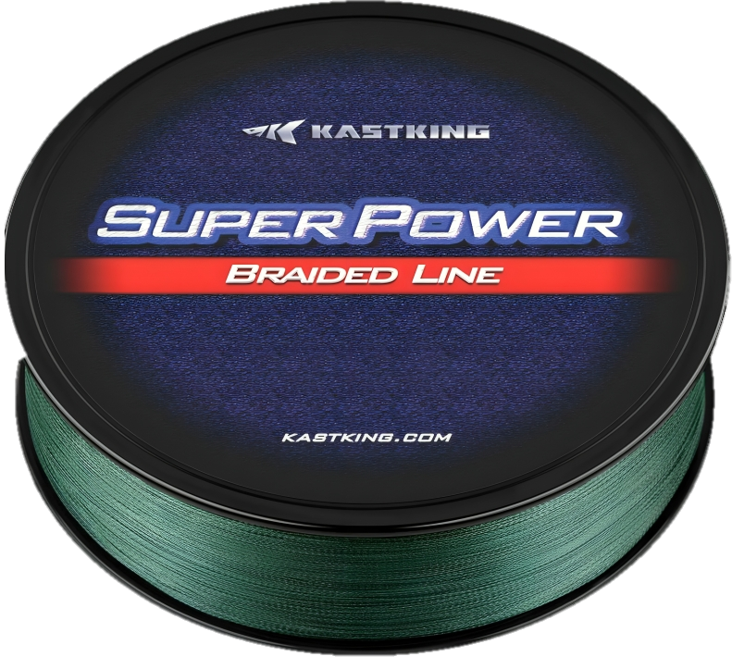
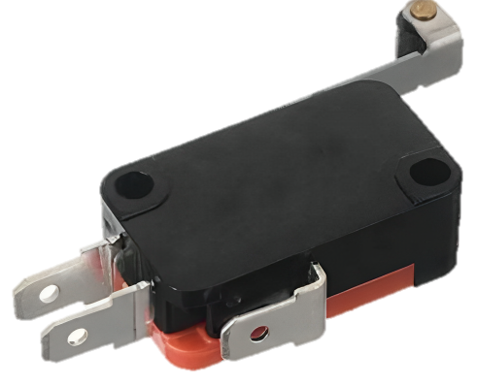
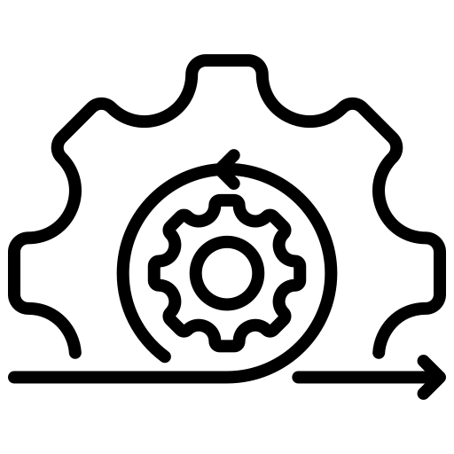
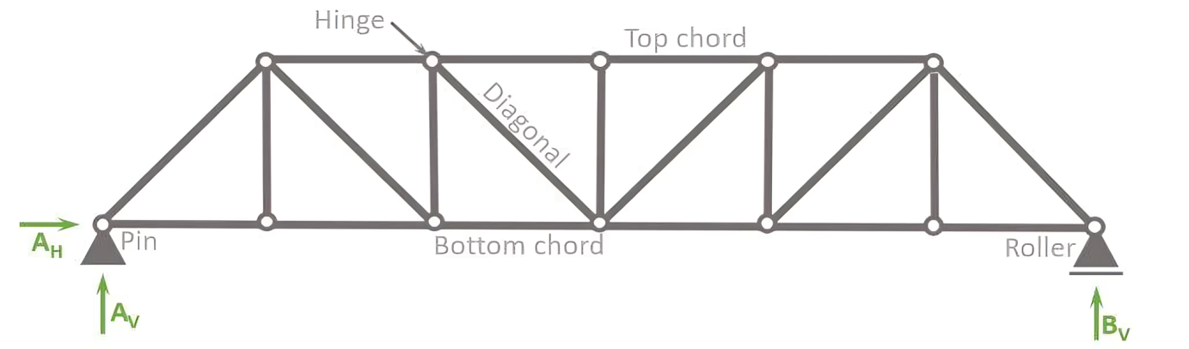
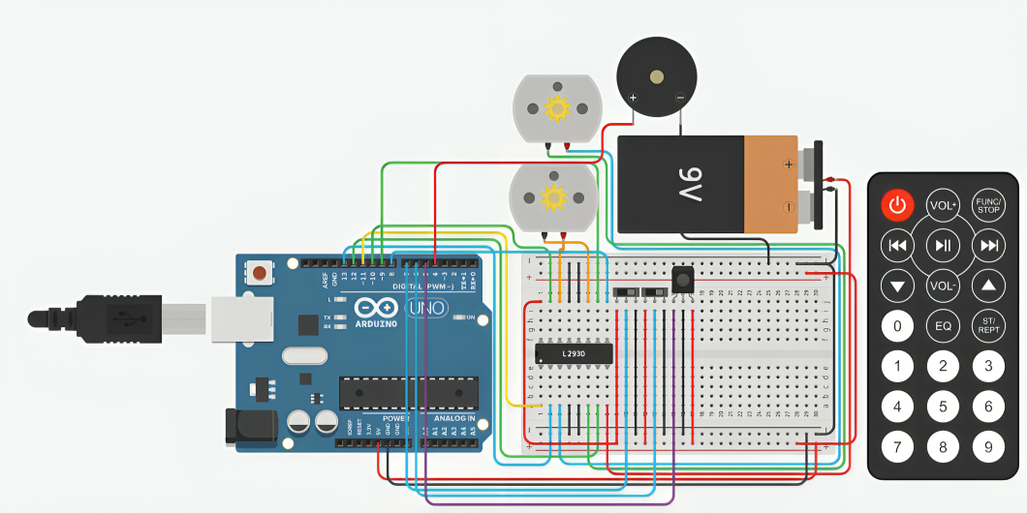

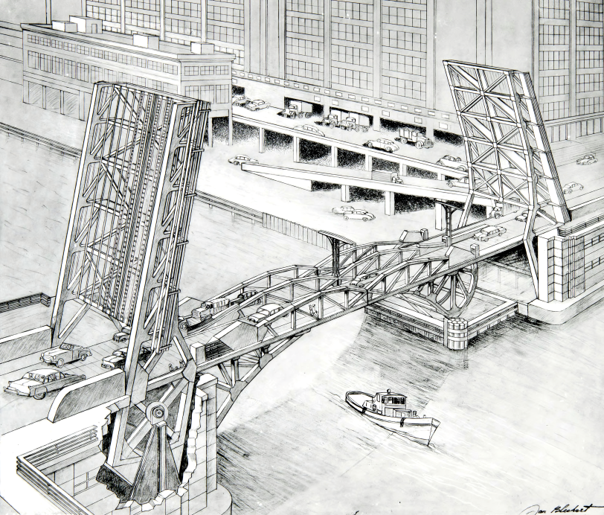
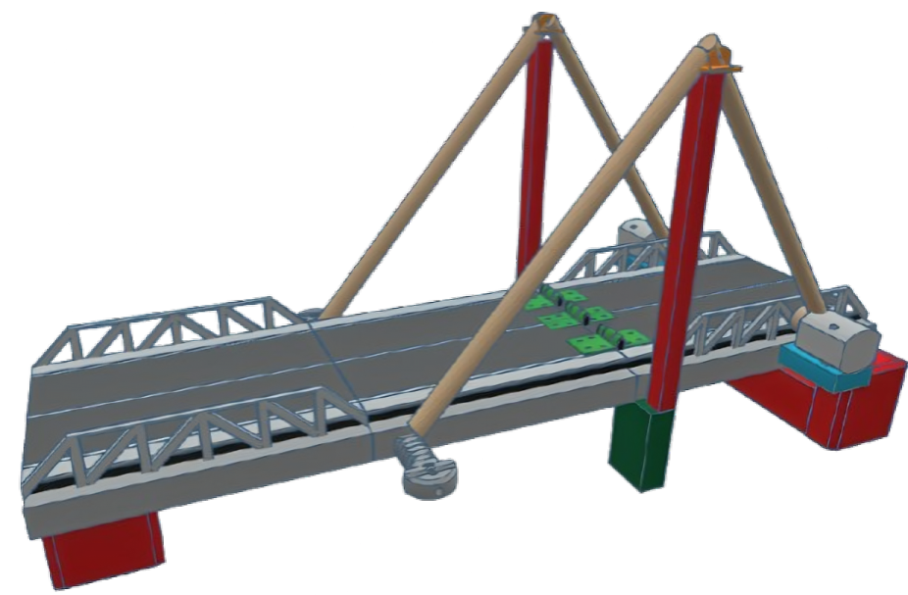
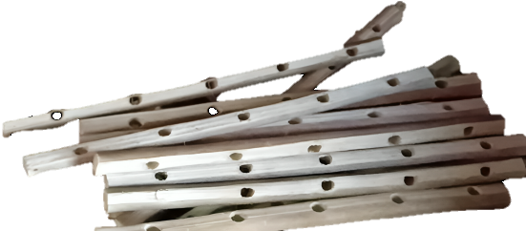
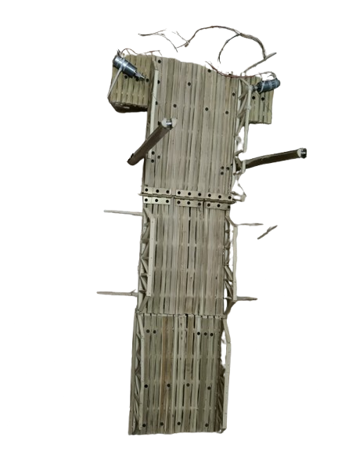



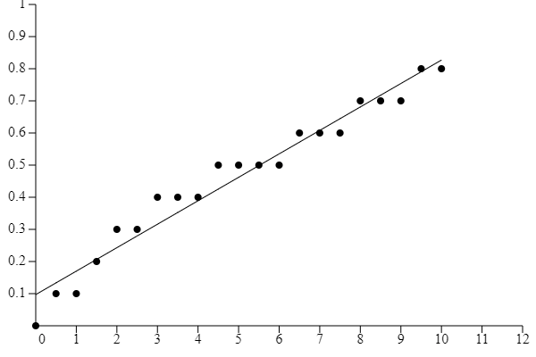

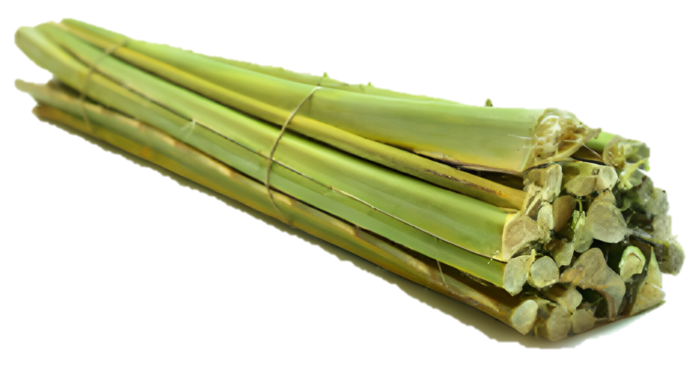
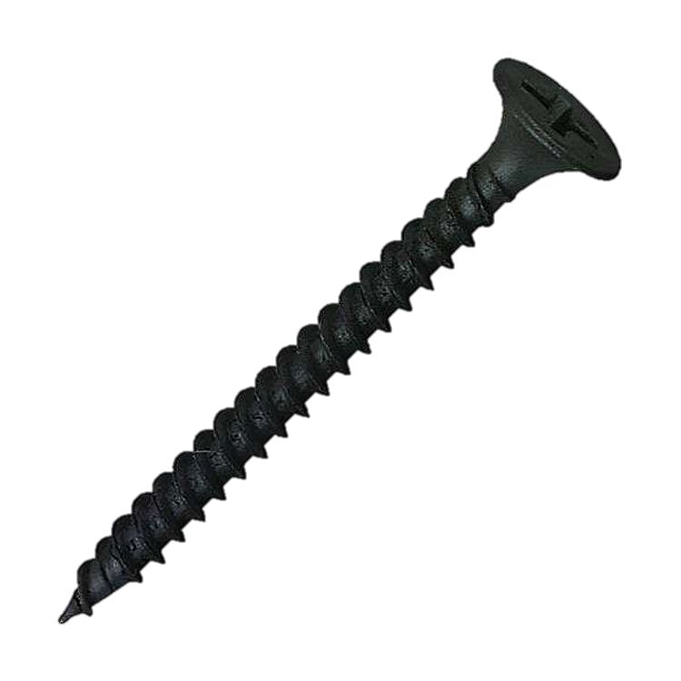
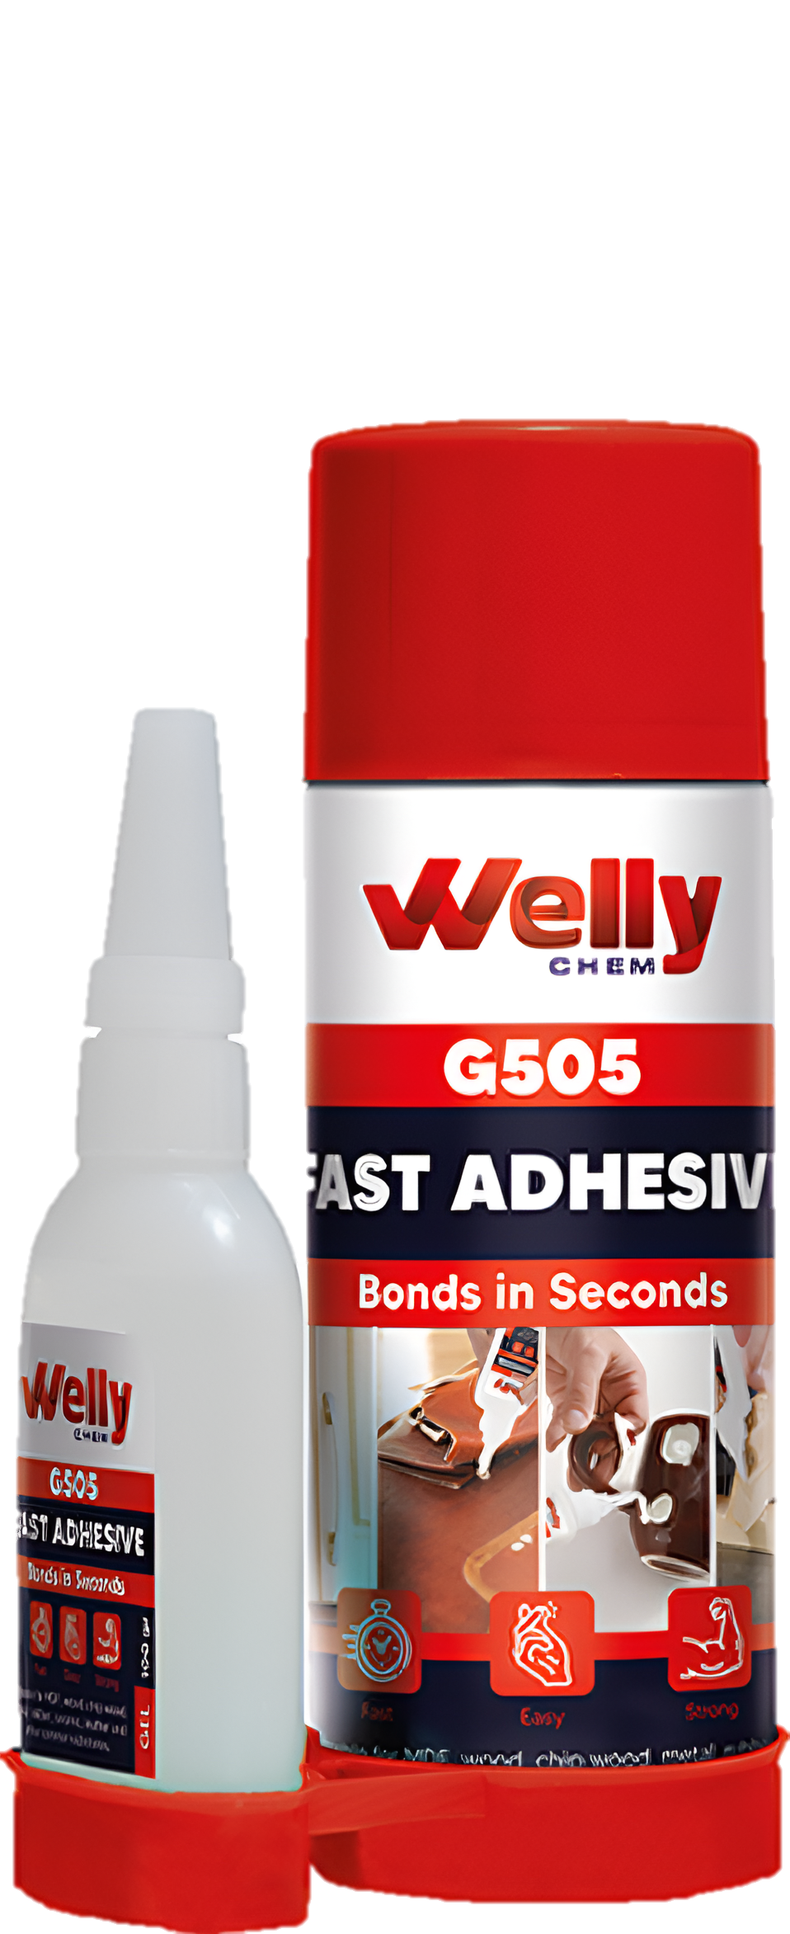
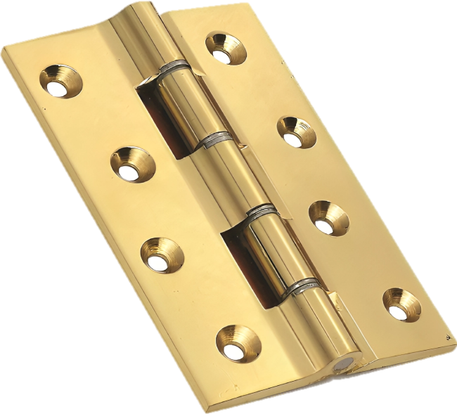
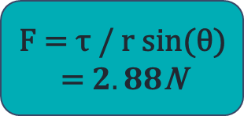
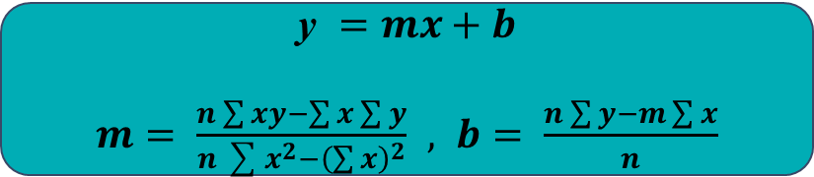
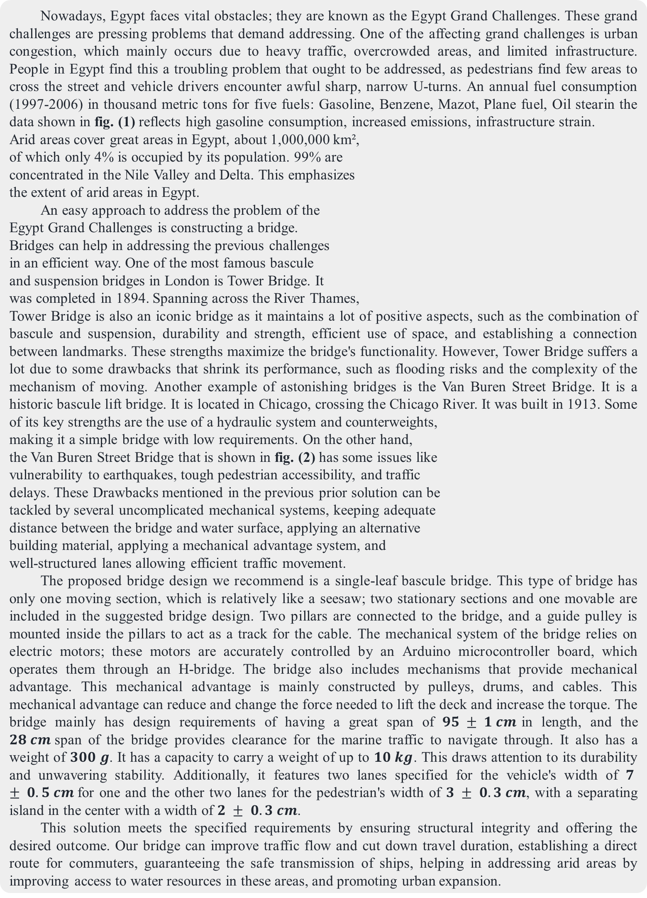
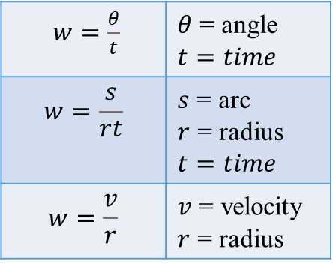
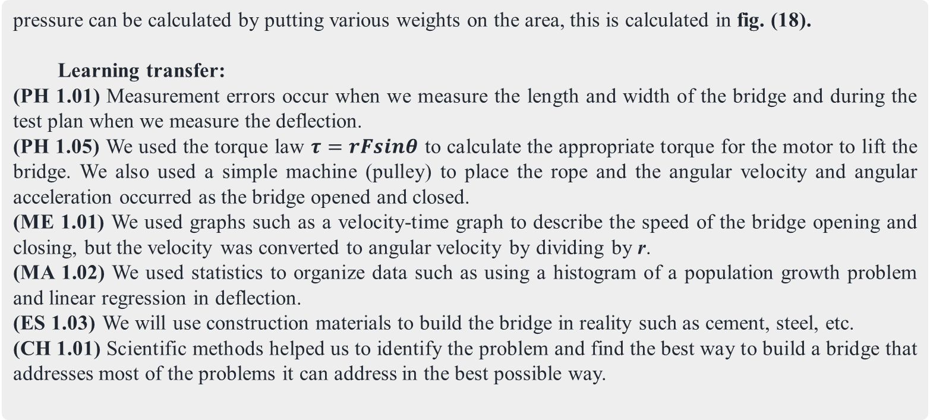
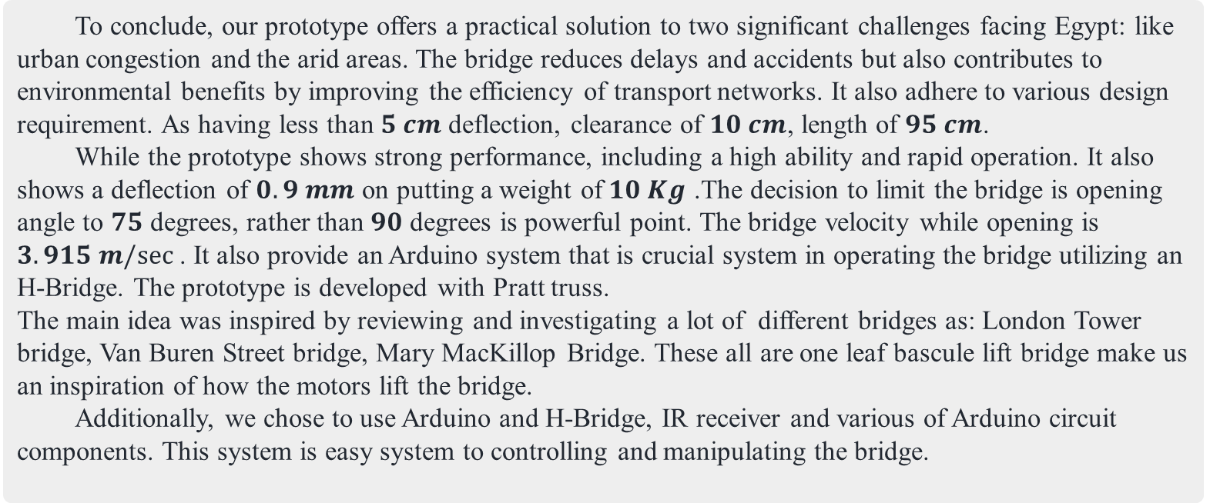
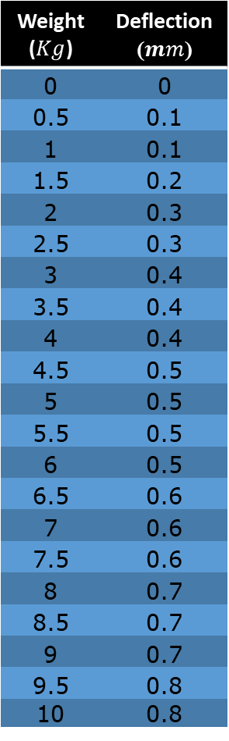

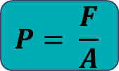
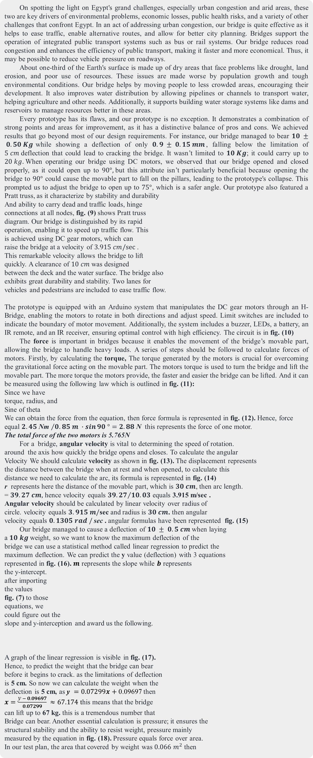
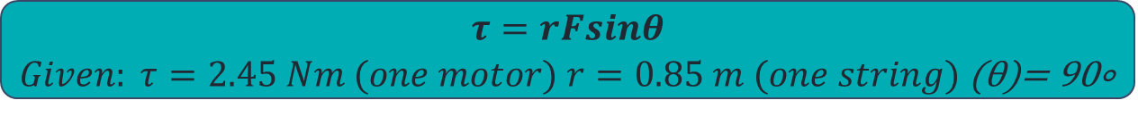
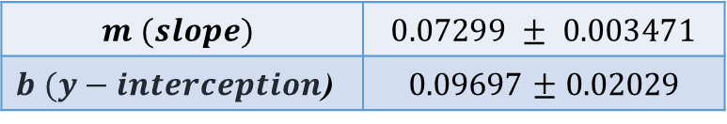
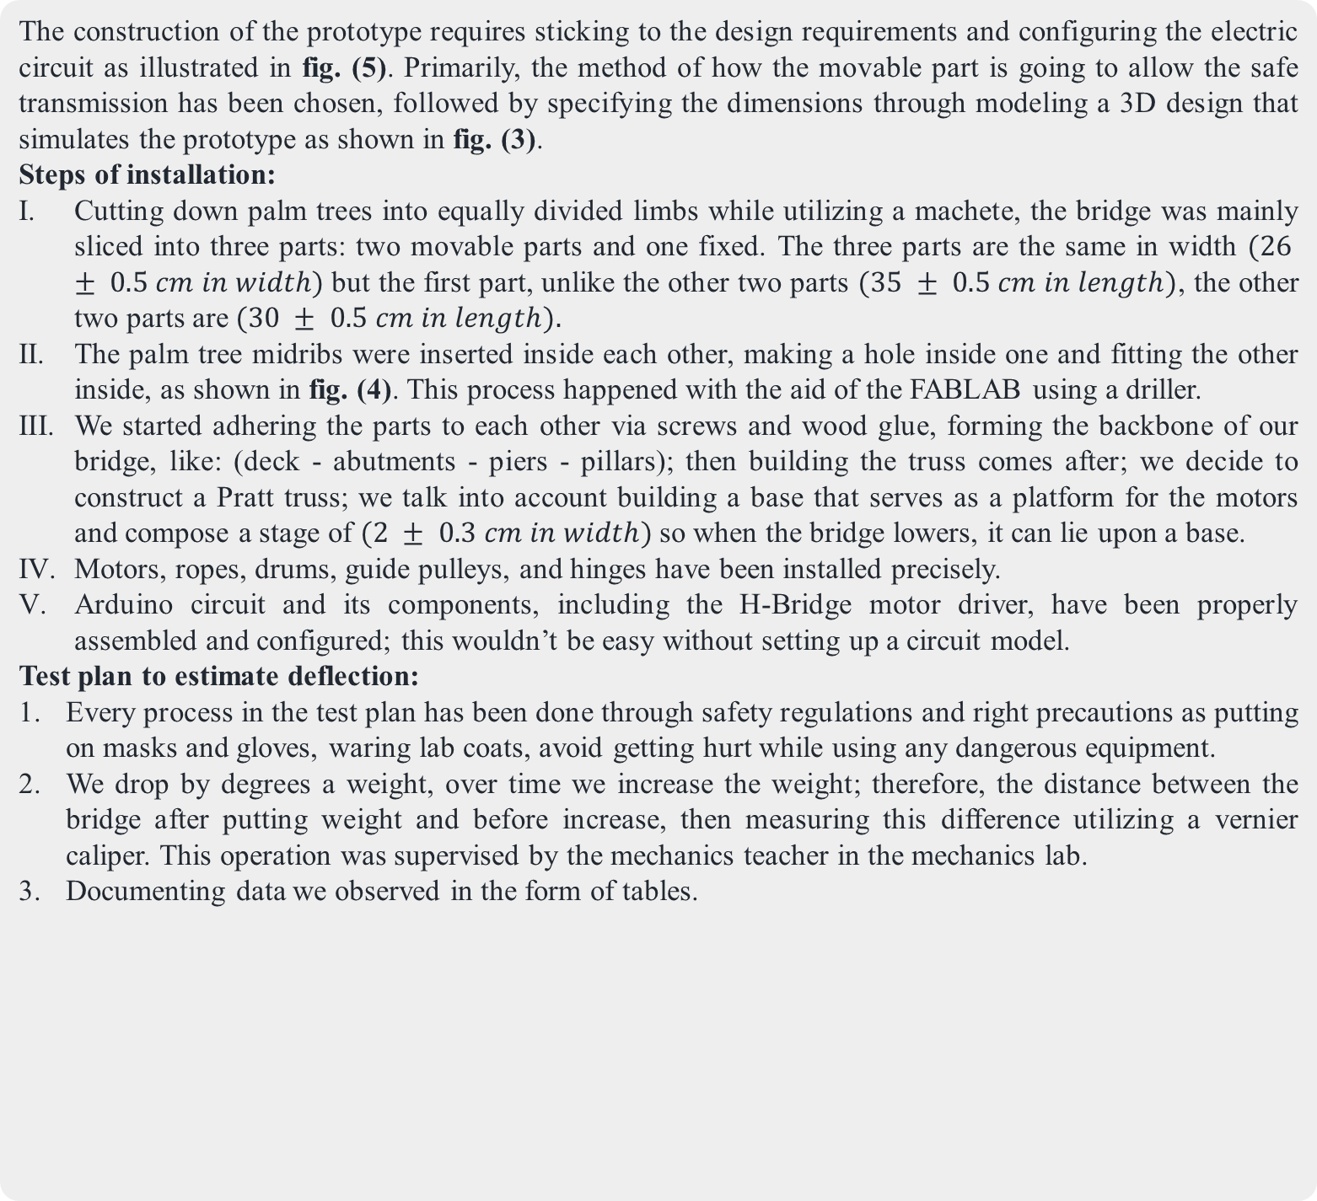

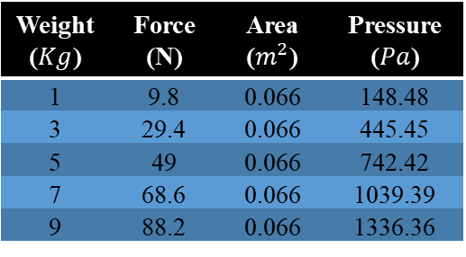
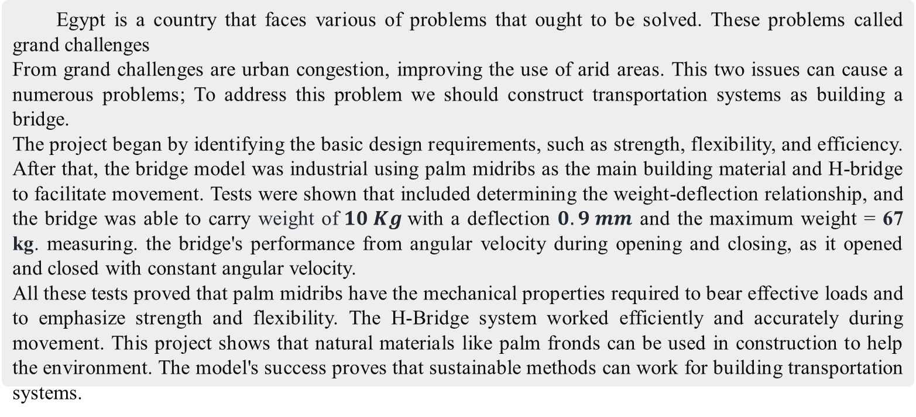

H-Bridge
Qena STEM School | 2024\2025 | Semester 1 | Grade 10 | Group No. 23110
Key words: Bridge – H-Bridge – Transportation – Palm Tree Midrib
Mahmoud Ahmed, Anas Ahmed, Philopateer Nabil, Ahmed Hazem, Ahmed Hassan
Abstract
Item | Usage | Picture | Item | Usage | Picture
Etqan-Arduino board | A board used to control electric components (dc motors, limit switches, IR receiver) |  | DC Motors | Lifting the movable part and towing the polyester rope.
IR receiver and IR remote | receive infrared signals from an IR remote controller to operate dc motor. |  | Jumper wires | Linking components to each other without need to soldering
H-Bridge Motor driver L293D | Electronic circuit used to control the direction and speed of a DC motor. |  | Battery | Guaranteeing sufficient voltage and current to DC motors.
Nylon fishing rope | Pulling and elevating the bridge via dc motors. |  | Limit switches | Used as an indicator to the limits of DC motor movement.
Analysis
pressure can be calculated by putting various weights on the area, this is calculated in fig. (18).
Learning transfer:
(PH 1.01) Measurement errors occur when we measure the length and width of the bridge and during the test plan when we measure the deflection.
(PH 1.05) We used the torque law $τ=rFsinθ$ to calculate the appropriate torque for the motor to lift the bridge. We also used a simple machine (pulley) to place the rope and the angular velocity and angular acceleration occurred as the bridge opened and closed.
(ME 1.01) We used graphs such as a velocity-time graph to describe the speed of the bridge opening and closing, but the velocity was converted to angular velocity by dividing by $\text{r}$.
(MA 1.02) We used statistics to organize data such as using a histogram of a population growth problem and linear regression in deflection.
(ES 1.03) We will use construction materials to build the bridge in reality such as cement, steel, etc.
(CH 1.01) Scientific methods helped us to identify the problem and find the best way to build a bridge that addresses most of the problems it can address in the best possible way.
Egypt is a country that faces various of problems that ought to be solved. These problems called grand challenges
From grand challenges are urban congestion, improving the use of arid areas. This two issues can cause a numerous problems; To address this problem we should construct transportation systems as building a bridge.
The project began by identifying the basic design requirements, such as strength, flexibility, and efficiency. After that, the bridge model was industrial using palm midribs as the main building material and H-bridge to facilitate movement. Tests were shown that included determining the weight-deflection relationship, and the bridge was able to carry weight of$10 Kg$with a deflection $0.9 mm$ and the maximum weight = 67 kg. measuring. the bridge's performance from angular velocity during opening and closing, as it opened and closed with constant angular velocity.
All these tests proved that palm midribs have the mechanical properties required to bear effective loads and to emphasize strength and flexibility. The H-Bridge system worked efficiently and accurately during movement. This project shows that natural materials like palm fronds can be used in construction to help the environment. The model's success proves that sustainable methods can work for building transportation systems.
On spotting the light on Egypt's grand challenges, especially urban congestion and arid areas, these two are key drivers of environmental problems, economic losses, public health risks, and a variety of other challenges that confront Egypt. In an act of addressing urban congestion, our bridge is quite effective as it helps to ease traffic, enable alternative routes, and allow for better city planning. Bridges support the operation of integrated public transport systems such as bus or rail systems. Our bridge reduces road congestion and enhances the efficiency of public transport, making it faster and more economical. Thus, it may be possible to reduce vehicle pressure on roadways.
About one-third of the Earth's surface is made up of dry areas that face problems like drought, land erosion, and poor use of resources. These issues are made worse by population growth and tough environmental conditions. Our bridge helps by moving people to less crowded areas, encouraging their development. It also improves water distribution by allowing pipelines or channels to transport water, helping agriculture and other needs. Additionally, it supports building water storage systems like dams and reservoirs to manage resources better in these areas.
Every prototype has its flaws, and our prototype is no exception. It demonstrates a combination of strong points and areas for improvement, as it has a distinctive balance of pros and cons. We achieved results that go beyond most of our design requirements. For instance, our bridge managed to bear $10 ± 0.50 Kg$while showing a deflection of only $0.9 ± 0.15 mm$, falling below the limitation of $5 cm$deflection that could lead to cracking the bridge. It wasn’t limited to $10 Kg$; it could carry up to $20 kg.$When operating our bridge using DC motors, we observed that our bridge opened and closed properly, as it could open up to $90°,$but this attribute isn’t particularly beneficial because opening the bridge to $90°$ could cause the movable part to fall on the pillars, leading to the prototype's collapse. This prompted us to adjust the bridge to open up to $75°$, which is a safer angle. Our prototype also featured a Pratt truss, as it characterize by stability and durability
And ability to carry dead and traffic loads, hinge
connections at all nodes, fig. (9) shows Pratt truss
diagram. Our bridge is distinguished by its rapid
operation, enabling it to speed up traffic flow. This
is achieved using DC gear motors, which can
raise the bridge at a velocity of $3.915 cm/sec⁡$.
This remarkable velocity allows the bridge to lift
quickly. A clearance of $10 cm$was designed
between the deck and the water surface. The bridge also
exhibits great durability and stability. Two lanes for
vehicles and pedestrians are included to ease traffic flow.
The prototype is equipped with an Arduino system that manipulates the DC gear motors through an H-Bridge, enabling the motors to rotate in both directions and adjust speed. Limit switches are included to indicate the boundary of motor movement. Additionally, the system includes a buzzer, LEDs, a battery, an IR remote, and an IR receiver, ensuring optimal control with high efficiency. The circuit is in fig. (10)
The force is important in bridges because it enables the movement of the bridge’s movable part, allowing the bridge to handle heavy loads. A series of steps should be followed to calculate forces of motors. Firstly, by calculating the torque, The torque generated by the motors is crucial for overcoming the gravitational force acting on the movable part. The motors torque is used to turn the bridge and lift the movable part. The more torque the motors provide, the faster and easier the bridge can be lifted. And it can be measured using the following law which is outlined in fig. (11):
Since we have
torque, radius, and
Sine of theta
We can obtain the force from the equation, then force formula is represented in fig. (12). Hence, force
equal ${2.45 \text{Nm} }/{0.85 m ∙\sin{90 °}}=2.88 \text{N}$ this represents the force of one motor.
The total force of the two motors is 5.765$\text{N}$
For a bridge, angular velocity is vital to determining the speed of rotation.
around the axis how quickly the bridge opens and closes. To calculate the angular
Velocity We should calculate velocity as shown in fig. (13). The displacement represents
the distance between the bridge when at rest and when opened, to calculate this
distance we need to calculate the arc, its formula is represented in fig. (14)
$\text{r}$ represents here the distance of the movable part, which is $30 cm$, then arc length.
= $39.27 cm,$ hence velocity equals ${39.27}/{10.03}$ equals 3.915 m/sec .
Angular velocity should be calculated by linear velocity over radius of
circle. velocity equals $3.915 m/$sec$⁡$and radius is $30 cm$. then angular
velocity equals $0.1305 rad /$sec$⁡$. angular formulas have been represented fig. (15)
Our bridge managed to cause a deflection of $10 ± 0.5 cm$when laying
a $10 kg$weight, so we want to know the maximum deflection of the
bridge we can use a statistical method called linear regression to predict the
maximum deflection. We can predict the y value (deflection) with 3 equations
represented in fig. (16). $m$ represents the slope while $b$ represents
the y-intercept.
after importing
the values
fig. (7) to those
equations, we
could figure out the
slope and y-interception and award us the following.
A graph of the linear regression is visible in fig. (17).
Hence, to predict the weight that the bridge can bear
before it begins to crack. as the limitations of deflection
is 5 cm. So now we can calculate the weight when the
deflection is 5 cm, as $\text{y} =0.07299x+\text{0.09697}$ then
​$x=\frac{\text{y} − 0.09697}{0.07299} ≈67.174$ this means that the bridge
can lift up to 67 kg. this is a tremendous number that
Bridge can bear. Another essential calculation is pressure; it ensures the
structural stability and the ability to resist weight, pressure mainly
measured by the equation in fig. (18). Pressure equals force over area.
In our test plan, the area that covered by weight was $0.066 m^{2}$ then
Conclusion
Introduction
To conclude, our prototype offers a practical solution to two significant challenges facing Egypt: like urban congestion and the arid areas. The bridge reduces delays and accidents but also contributes to environmental benefits by improving the efficiency of transport networks. It also adhere to various design requirement. As having less than $5 cm$deflection, clearance of $10 cm$, length of $95 cm$.
While the prototype shows strong performance, including a high ability and rapid operation. It also shows a deflection of $0.9 mm$ on putting a weight of$10 Kg$ .The decision to limit the bridge is opening angle to $75$ degrees, rather than $90$ degrees is powerful point. The bridge velocity while opening is $3.915 m/sec⁡$. It also provide an Arduino system that is crucial system in operating the bridge utilizing an H-Bridge. The prototype is developed with Pratt truss.
The main idea was inspired by reviewing and investigating a lot of different bridges as: London Tower bridge, Van Buren Street bridge, Mary MacKillop Bridge. These all are one leaf bascule lift bridge make us an inspiration of how the motors lift the bridge.
Additionally, we chose to use Arduino and H-Bridge, IR receiver and various of Arduino circuit components. This system is easy system to controlling and manipulating the bridge.
Nowadays, Egypt faces vital obstacles; they are known as the Egypt Grand Challenges. These grand challenges are pressing problems that demand addressing. One of the affecting grand challenges is urban congestion, which mainly occurs due to heavy traffic, overcrowded areas, and limited infrastructure. People in Egypt find this a troubling problem that ought to be addressed, as pedestrians find few areas to cross the street and vehicle drivers encounter awful sharp, narrow U-turns. An annual fuel consumption (1997-2006) in thousand metric tons for five fuels: Gasoline, Benzene, Mazot, Plane fuel, Oil stearin the data shown in fig. (1) reflects high gasoline consumption, increased emissions, infrastructure strain.
Arid areas cover great areas in Egypt, about 1,000,000 km²,
of which only 4% is occupied by its population. 99% are
concentrated in the Nile Valley and Delta. This emphasizes
the extent of arid areas in Egypt.
An easy approach to address the problem of the
Egypt Grand Challenges is constructing a bridge.
Bridges can help in addressing the previous challenges
in an efficient way. One of the most famous bascule
and suspension bridges in London is Tower Bridge. It
was completed in 1894. Spanning across the River Thames,
Tower Bridge is also an iconic bridge as it maintains a lot of positive aspects, such as the combination of bascule and suspension, durability and strength, efficient use of space, and establishing a connection between landmarks. These strengths maximize the bridge's functionality. However, Tower Bridge suffers a lot due to some drawbacks that shrink its performance, such as flooding risks and the complexity of the mechanism of moving. Another example of astonishing bridges is the Van Buren Street Bridge. It is a historic bascule lift bridge. It is located in Chicago, crossing the Chicago River. It was built in 1913. Some of its key strengths are the use of a hydraulic system and counterweights,
making it a simple bridge with low requirements. On the other hand,
the Van Buren Street Bridge that is shown in fig. (2) has some issues like
vulnerability to earthquakes, tough pedestrian accessibility, and traffic
delays. These Drawbacks mentioned in the previous prior solution can be
tackled by several uncomplicated mechanical systems, keeping adequate
distance between the bridge and water surface, applying an alternative
building material, applying a mechanical advantage system, and
well-structured lanes allowing efficient traffic movement.
The proposed bridge design we recommend is a single-leaf bascule bridge. This type of bridge has only one moving section, which is relatively like a seesaw; two stationary sections and one movable are included in the suggested bridge design. Two pillars are connected to the bridge, and a guide pulley is mounted inside the pillars to act as a track for the cable. The mechanical system of the bridge relies on electric motors; these motors are accurately controlled by an Arduino microcontroller board, which operates them through an H-bridge. The bridge also includes mechanisms that provide mechanical advantage. This mechanical advantage is mainly constructed by pulleys, drums, and cables. This mechanical advantage can reduce and change the force needed to lift the deck and increase the torque. The bridge mainly has design requirements of having a great span of $95 ± 1 cm$in length, and the $28 cm$span of the bridge provides clearance for the marine traffic to navigate through. It also has a weight of $300 g$. It has a capacity to carry a weight of up to $10 kg$. This draws attention to its durability and unwavering stability. Additionally, it features two lanes specified for the vehicle's width of $7 ± 0.5 cm$for one and the other two lanes for the pedestrian's width of $3 ± 0.3 cm$, with a separating island in the center with a width of $2 ± 0.3 cm$.
This solution meets the specified requirements by ensuring structural integrity and offering the desired outcome. Our bridge can improve traffic flow and cut down travel duration, establishing a direct route for commuters, guaranteeing the safe transmission of ships, helping in addressing arid areas by improving access to water resources in these areas, and promoting urban expansion.
Methods
Fig-9
Fig-1
The construction of the prototype requires sticking to the design requirements and configuring the electric circuit as illustrated in fig. (5). Primarily, the method of how the movable part is going to allow the safe transmission has been chosen, followed by specifying the dimensions through modeling a 3D design that simulates the prototype as shown in fig. (3).
Steps of installation:
Cutting down palm trees into equally divided limbs while utilizing a machete, the bridge was mainly sliced into three parts: two movable parts and one fixed. The three parts are the same in width $(26 ± 0.5 cm in width)$but the first part, unlike the other two parts $(35 ± 0.5 cm in length)$, the other two parts are $(30 ± 0.5 cm in length).$
The palm tree midribs were inserted inside each other, making a hole inside one and fitting the other inside, as shown in fig. (4). This process happened with the aid of the FABLAB using a driller.
We started adhering the parts to each other via screws and wood glue, forming the backbone of our bridge, like: (deck - abutments - piers - pillars); then building the truss comes after; we decide to construct a Pratt truss; we talk into account building a base that serves as a platform for the motors and compose a stage of $(2 ± 0.3 cm in width)$so when the bridge lowers, it can lie upon a base.
Motors, ropes, drums, guide pulleys, and hinges have been installed precisely.
Arduino circuit and its components, including the H-Bridge motor driver, have been properly assembled and configured; this wouldn’t be easy without setting up a circuit model.
Test plan to estimate deflection:
Every process in the test plan has been done through safety regulations and right precautions as putting on masks and gloves, waring lab coats, avoid getting hurt while using any dangerous equipment.
We drop by degrees a weight, over time we increase the weight; therefore, the distance between the bridge after putting weight and before increase, then measuring this difference utilizing a vernier caliper. This operation was supervised by the mechanics teacher in the mechanics lab.
Documenting data we observed in the form of tables.
Fig-10
Cite 1
Cite 5
Recommendation
There is no perfect prototype, and our prototype is no exception. We recommend some features and attributes that can make major effects in the bridge that could help in improving the application and efficiency of our project. For people who want to follow some footsteps in the improvement of this project, they can do
1. Try to use renewable energy, especially solar panels, to power the motors because this will be better than using batteries. This will save as much electricity as possible.
2. Try to use stronger materials than palm midribs, and we suggest using cement and steel. As palm tree midribs are not strong enough material, take into consideration using recycled materials.
3. We suggest using ultrasonic sensors instead of using a remote control. This can make a system of automatic operating that can open only when passing ships.
4. Install a drainage system to channel rainwater away to prevent water from damaging parts of the bridge.
5. Use smart cameras to monitor traffic or road conditions; this can be effective in recording what happens on the road and shipping water paths; this can also give information on incoming ships and water traffic.
6. Provide green spaces. This can happen by planting green areas in pedestrian lanes; this can reduce carbon dioxide gases emitted by cars and vehicles.
Fig-2
Fig-11
$$τ=rFsinθ$$
$Given: τ=2.45 Nm (one motor) r=0.85 m (one string)$ (θ)= 90∘
Cite 2
Cite 3
Fig-12
$$\text{F} \text{= }\text{τ}\text{ / }\text{r} \text{sin}\text{(}\text{θ}\text{)}$$
= $2.88\text{N}$
Fig-3
Fig-4
Fig-5
Fig-13
$$\overline{v}=\frac{Δx}{Δt}$$
Fig-14
Literature cited
Results
$$arc=\text{2 }\text{π} \text{r}\text{ (}\text{θ}\text{/360}\text{°}\text{)}$$
Fig-15
El-Kadi, A. W. (2013). Suggested solutions for traffic congestion in Greater Cairo. Journal of sustainable development, 6(11), 105. https://pdfs.semanticscholar.org/60bf/4433d86870bc77953d0d88d1d30f0bca3666.pdf
McBriarty, P. T. (2013). Chicago River Bridges. University of Illinois Press https://books.google.ru/books?id=YAzDCwAAQBAJ&q=chicago+River+Bridges+book
Serway, R. A., Jewett, J. W., Wilson, K., & Rowlands, W. (2016). Physics for Global Scientists and Engineers, Volume 2 (Vol. 2). Cengage AU. https://archive.org/details/SerwayJewettPhysicsForScientistsAndEngineersWithModernPhysics9ed
Illowsky, B., & Dean, S. (2013). Introductory Statistics 2e. OpenStax
https://assets.openstax.org/oscms-prodcms/media/documents/IntroductoryStatistics-OP_i6tAI7e.pdf
5. Arduino Servo Motor Control with Motor Driver Shield L293D. (n.d.). Arduino Project Hub.
https://projecthub.arduino.cc/Fouad_Roboticist/arduino-servo-motor-control-with-motor-driver-shield-l293d-beab43
Angular velocity formulas
A detailed representation of the weight-deflection relationship is provided in the graph and table.
$w=\frac{θ}{t}$ | $θ$ = angle $$t=time$$
$$w=\frac{s}{rt}$$ | $s$ = arc $r$ = radius $$t=time$$
$$w=\frac{v}{r}$$ | $v$ = velocity $r$ = radius
Fig-6
Fig-7
Weight ($Kg$) | Deflection ($mm$)
0 | 0
0.5 | 0.1
1 | 0.1
1.5 | 0.2
2 | 0.3
2.5 | 0.3
3 | 0.4
3.5 | 0.4
4 | 0.4
4.5 | 0.5
5 | 0.5
5.5 | 0.5
6 | 0.5
6.5 | 0.6
7 | 0.6
7.5 | 0.6
8 | 0.7
8.5 | 0.7
9 | 0.7
9.5 | 0.8
10 | 0.8
Fig-16
$$\text{y} =mx+b$$
$m= \frac{n\sum{xy}−\sum{x}\sum{y}}{n\sum{x^{2}}−{\left(\sum{x}\right)}^{2}}$ $, b= \frac{n\sum{y}−m\sum{x}}{n}$
Materials
Cite 4
$$m (slope)$$ | $$0.07299 ± 0.003471$$
$b (y−interception$) | 0.09697 ± 0.02029
$$\text{y} =0.07299x+\text{0.09697}$$
Fig-17
Item | Usage | Picture | Item | Usage | Picture
Palm Tree Midribs | It will be utilized to fabricate various components of the bridge. |  | Screws | Attach the superstructure and the hinges with the substructure.
Wood glue | Bond the stalks together and provide strength and durability. |  | Hinges | Allow the movable part to rotate around fixed axis.
Contact INFO
Fig-8
Velocity time graph of opening and closing
Anas.2324015@stemqena.moe.edu.eg
Ahmed.2324003@stemqena.moe.edu.eg
Ahmed.2324004@stemqena.moe.edu.eg
Philopateer.2324039@stemqena.moe.edu.eg
Mahmoud.2324055@stemqena.moe.edu.eg
$$P= \frac{F}{A}$$
Fig-18
Fig-19
Weight ($Kg$) | Force (N) | Area ($m^{2}$) | Pressure ($Pa$)
1 | 9.8 | 0.066 | 148.48
3 | 29.4 | 0.066 | 445.45
5 | 49 | 0.066 | 742.42
7 | 68.6 | 0.066 | 1039.39
9 | 88.2 | 0.066 | 1336.36

